Slide 1

IMDB MOVIE ANALYSIS

Slide 2
PROJECT DESCRIPTION
Problem Statement: The dataset provided is related to IMDB Movies. A potential problem to investigate could be: "What factors influence the success of a movie on IMDB?"
Here, success can be defined by high IMDB ratings. The impact of this problem is significant for movie producers, directors, and investors who want to understand what makes a movie successful to make informed decisions in their future projects.
So as a Data analyst, analysing IMDB could potentially provide insights, patterns and recommendations so that it could influence future projects and could possibly thrive for growth related to projects
The primary Attributes which we would analyse includes
Title name
Genres
Directors
Cast and crew

Slide 3
Duration
IMDB score
Ratings
Reviews
Awards and nominations
Box office earnings
And the list goes on with various factors effecting film’s success or failure
Data Cleaning:
This step involves preprocessing the data to make it suitable for analysis. It includes handling missing values, removing duplicates, converting data types if necessary, and possibly feature engineering.
So as of now we’ve been provided with a dataset which consists of numerous columns and some of them aren’t actually needed to go through as that wouldn’t affect overall so I would like to remove columns which aren’t needed
I would like to cut down which aren’t that of use
List of columns I’ve taken out are as follows
Color
num_critic_for_reviews

Slide 4
director_facebook_likes
actor_3_facebook_likes
actor_2_name
actor_1_facebook_likes
num_voted_users
cast_total_facebook_likes
actor_3_name
facenumber_in_poster
plot_keywords
movie_imdb_link
num_user_for_reviews
country
content_rating
actor_2_facebook_likes
aspect_ratio
movie_facebook_likes
so these were the columns in my opinion which wouldn’t add on or remove important factors which could affect movie’s success or failure

Slide 5
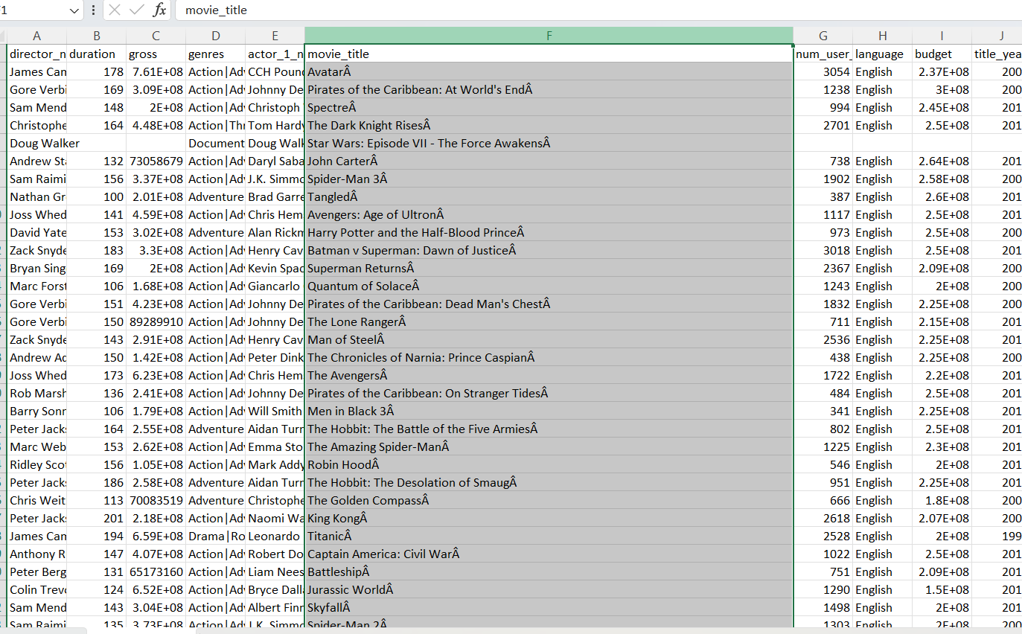
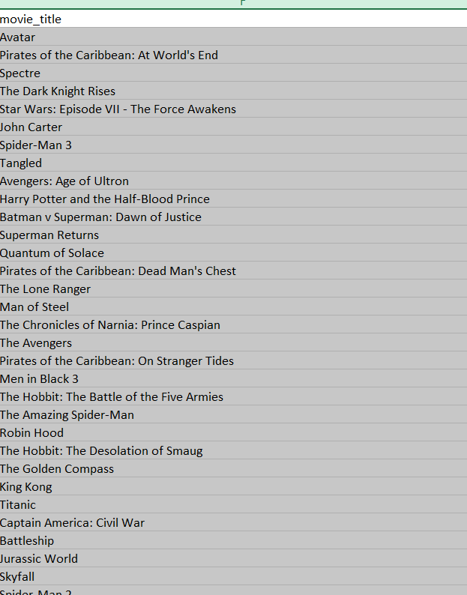
with the following I’ve also cleared out blank cells as well as duplicate cells so that I wouldn’t have any problem while analysing data
Removing blank cells is very convenient all we have to do is click ctrl+A and then click find & select, go to special then select blanks it highlights blanks either click ctrl+- or directly in home tab we have delete cells option that’s it
And to remove duplicates, we have very easily accessible Data tab in which we have tool called remove duplicates we can select ctrl+A, go to data click remove duplicates
There’s a extra letter Â I replaced it with space

Slide 6
PROJECT APPROACH
As a data analyst, my approach for this specific task was, Firstly I’ve downloaded the dataset and made it very optimum so that it couldn’t make complications while doing tasks and then I went on cleaning the dataset as mentioned above
Then using excel I performed analysis on the data accordingly, As a analyst it’s very crucial thing to clean and prepare data so that data is structured, accurate, and ready for analysis.it involved removing blank cells, duplicate values, detecting & handling outliers, and also feature engineering
And as given tasks mentioned we need to do some descriptive Statistics using different excel functions so that it enhances our statistical skills as well as excel skills
We also used various visualization tools to represent solution creatively and explaining it through different charts and graphs makes us understand very easily as well as it summarizes our data
As mentioned in the project description here we have a great understanding of what we are going to do with the IMDB movie analysis

Slide 7
Five 'Whys' Approach: This technique will help you dig deeper into the problem. For instance, if you find that movies with higher budgets tend to have higher ratings, you can ask "Why?" repeatedly to uncover the root cause. Here's an example:
Q: "Why do movies with higher budgets tend to have higher ratings?"
A: They can afford better production quality.
Q: "Why does better production quality lead to higher ratings?"
A: It enhances the viewer's experience.
Q: "Why does an enhanced viewer experience lead to higher ratings?"
A: Viewers are more likely to rate a movie highly if they enjoyed watching it.
Q: "Why are viewers more likely to rate a movie highly if they enjoyed watching it?"
A: Positive experiences lead to positive reviews.
Q: "Why do positive reviews matter?"
A: They influence other viewers' decisions to watch the movie, increasing its popularity and success.

Slide 8
Through this we have done root cause analysis as it can provide new revelations, insights, recommendations as well as different approaches to change accordingly for a better outcome as it is very important to see through viewer’s perspective
In general, movies work well with different factors
If the Hero/Heroine has huge fan following, film works even the storyline is great or not
Hero’s/Heroine’s from film backgrounds also make film work better, through legacy their family or known has, have or had
Film promotions do lot of work in movie’s success
Reputed and established directors also play a major role in movie’s success
Movie budgeting makes a huge difference cause a great storyline with less budget and production wouldn’t reach those heights as of others
Movie Critics do work differently because they provide their own perspectives, recommendations, opinions accordingly which makes people indecisive about a movie
IMDB scores also make a difference
For New comers, people would have skeptical opinions
And the list goes on, this gives us deep analysis towards movies about how each and every factor makes a hit or pass

Slide 9
TECH STACK USED
For this project ,I’ve used Microsoft excel for Data cleaning, preparing, analysing ,visualizing, manipulating etc……….
Used ribbon layout(Home, Insert, Formulas, Data, Review, View, Help) the most as it is very crucial, used pivot table, various formula’s & functions ,visualization tools & Statistical Analysis etc..

Slide 10
Insights
Here’s the thing, I’ve written insight for each & every task as I can’t summarize all the insights into one cause every task has its own various insights patterns & summaries
A. Movie Genre Analysis: Analyse the distribution of movie genres and their impact on the IMDB score.
Task: Determine the most common genres of movies in the dataset. Then, for each genre, calculate descriptive statistics (mean, median, mode, range, variance, standard deviation) of the IMDB scores.
Insights:
As I presented my excel sheet where u could go through each & every process
As mentioned, to separate genres, select genre column and select the data tab in which select from table/range, it’ll redirect to power query editor in which we need to select split column by delimiter then split at each occurrence of the delimiter advance option split into rows then ok we get it as
And next I’ve filtered out all the genres, and with the help of countif function I did count of genres (=COUNTIF(B:B,"*" & E2 & "*")

Slide 11

And as it was mentioned to do descriptive statistics for each & every genre, I did took out the mean, median, mode, max, min , variance, standard deviation.
Mean: =AVERAGEIF (B: B,"*" & E2 & "*”, A: A)
Median: =MEDIAN(IF(ISNUMBER(SEARCH("*"&Table1[@GENRES]&"*",B:B)),A:A))
Mode: =MODE(IF(ISNUMBER(SEARCH("*"&Table1[@GENRES]&"*",B:B)),A:A))
Max: =MAXIFS(A:A,B:B,"*" & E2 & "*")
Min: =MINIFS(A:A,B:B,"*" & E2 & "*")
Variance: =VAR(IF(ISNUMBER(SEARCH("*"&Table1[@GENRES]&"*",B:B)),A:A))
Standard deviation: =STDEV(IF(ISNUMBER(SEARCH("*"&Table1[@GENRES]&"*",B:B)),A:A))
Identified top 5 genres from the genre table
Also, with the help of genre table used a chart is represented to understand it more precisely
Result:

Slide 12
B. Movie Duration Analysis: Analyze the distribution of movie durations and its impact on the IMDB score.
Task: Analyze the distribution of movie durations and identify the relationship between movie duration and IMDB score.
Insights:
In the movie duration analysis I’ve taken out duration and imdb_score column from the cleaned dataset and I’ve calculate mean median & standard deviation using excel functions for movie duration as mentioned
Mean: =AVERAGE(A:A)
Median: =MEDIAN(A:A)
Standard deviation: =STDEV.S(A:A)
Created a scatter plot to visualize the relationship between movie duration and IMDB score. And also added a trendline to assess the direction and strength of the relationship to create a scatter plot we need to select both the columns and click on insert and then the recommended charts cause it’ll recommend the best chart that suits according to our selection of column then when u get the scatter plot when u double click there’s (+) which is to add a element then select the trendline, it’s to show the general direction (increase, decrease, or constant) of the data. And from scatterplot we got to see it’s a constant relationship so far between movie duration and imdb score

Slide 13

I’ve attached my Microsoft excel sheet to understand my task more accurately
Result:
C. Language Analysis: Situation: Examine the distribution of movies based on their language.
Task: Determine the most common languages used in movies and analyze their impact on the IMDB score using descriptive statistics.
Insights: I’ve taken out the language and imdb_score column from a cleaned dataset and filtered out all the languages and did the count of languages with the help of countif function and as well as mentioned to calculated descriptive stastistics of imdb_score for each genre I did using mean ,median, standard deviation functions
Count of genres: =COUNTIF(C:C,E2)
Mean: =AVERAGEIF(C:C,E2,A:A)
Median: =MEDIAN(IF(C:C=Table1[@LANGUAGES],A:A))

Slide 14

This formula is an array formula in Excel that calculates the median of a set of values in column A, but only for rows where the value in column C matches a specific value from the Table1[@LANGUAGES] cell. IF function creates an array of values from column A, but only for the rows where column C equals the specified language in Table1[@LANGUAGES].
Standard deviation: =STDEV(IF(C:C=Table1[@LANGUAGES],A:A))
This formula is used to calculate the standard deviation of a subset of values in column A, based on a condition applied to column C. It uses an array formula to perform this calculation. IF function that filters values in column A based on a condition applied to column C.
This’s how I’ve done the task with the knowledge I’ve acquired during learning sessions as well as with the help of hint given in the description
Result:

Slide 15
D. Director Analysis: Influence of directors on movie ratings.
Task: Identify the top directors based on their average IMDB score and analyze their contribution to the success of movies using percentile calculations.
Insights: From the cleaned data, I’ve taken out director’s column &imdb_score and Calculated the average IMDB score for each director. With the help of Excel's PERCENTILE function to identify the directors with the highest scores ,to calculate average I used average function
Average: =AVERAGEIF(B:B,B2,A:A)
Percentile: PERCENTRANK.EXC(C2:C4721,C2)
To know the top directors with highest scores I’ve used
=INDEX(SORTBY(B2:C4721,D2:D4721,-1,B2:B4721,1),SEQUENCE(10),{1,2})
It’s a powerful and complex formula in Excel that retrieves specific rows and columns of sorted data, this formula is used to return a sorted subset of data, specifically the first 10 rows, sorted by column D in descending order, and then by column B in ascending order. Eventually it would return the first 10 rows from this sorted data, then again from the data we’ve gotten with the formula usage the top directors, I’ve used a chart to visualize the data so that it could be understood properly

Slide 16

Result :
E. Budget Analysis: Explore the relationship between movie budgets and their financial success.
Task: Analyze the correlation between movie budgets and gross earnings, and identify the movies with the highest profit margin.
Insights:
From the cleaned data, I’ve taken out imdb_score, movie title, gross, budget columns and calculated profit by subtracting gross by budget got the profit and then the calculated the correlation coefficient between movie budgets and gross earnings using Excel's correl function
Correl function: =CORREL(E2:E3781,D2:D3781)
It calculated the correlation coefficient between two sets of data columns E and D to understand the strength and direction of the linear relationship between them
And to know the movies with the highest profit margin with using excel MAX function I’ve used

Slide 17
=IF(F2:F3781=MAX(F2:F3781),C2:C3781,"")
It’s an array formula that checks each value in a range and returns a corresponding value from another range if a condition is met
It checks if the value in column F (for a specific row) is equal to the maximum value in column F.
If the value in column F is equal to the maximum value, it returns the value from the same row in column C.
If the value in column F is not equal to the maximum, it returns an empty string.
This formula finds the maximum value in column F and then returns the corresponding value from column C for rows where the value in F equals the maximum value. Otherwise, it leaves the cell empty.
And also to know top 5 movie titles I’ve used
=INDEX(SORTBY(C:C,F:F,-1),SEQUENCE(6))
The formula is used to return the top 6 values from column C, sorted based on the values in column F in descending order.
As it also included movie title, I’ve increased sequence with 6 number so that I get top 5 movie title with highest profit

Slide 18

It Sorts the values in column C based on the corresponding values in column F (in descending order).
Returns the top 6 values from column C based on that sorted order.
It gives a top 5 list based on their ranking
Result:

Slide 19


